Slide 1
ANZEWON Meeting, Melbourne - 22 November 2017
Exempt Customers and Dispute Resolution
Jo De Silva South Australian Council of Social Service
Bev Hughson, Darach Energy

Slide 2
Presentation Overview
Summary of situation these customers are facing
Review of the changing framework:
recent AEMC market review
the AER reviews of the exemption guidelines
Conclusions

Slide 3
Appropriate External Dispute Resolution
Other dispute resolution avenues available are more formal / legal, more costly, less accessible and do not have expertise in resolving energy and water disputes
Ombudsman schemes use flexible dispute resolution mechanisms (investigation, conciliation and mediation) which is more appropriate for vulnerable customers
Ombudsman schemes play an important role in the energy sector, operating as a check and balance, producing reports and submissions which influence policy
Ombudsman schemes undertake extensive outreach work, connecting with communities, improving communication and understanding of energy entities and customer concerns
The membership and fee structures can be amended to cater to the various capacities of exempt entities (noting the aim of no cross-subsidisation among members)
Where consumers have access to ombudsman schemes,
there is a reduced need for further regulation

Slide 4
Consumer Issues
Unexplained variations on the amount payable on the bill, even when the resident believed their consumption patterns have not changed;
A lack of transparency on charges – residents are not always notified when arrangements change and there is no transparency if formal reductions (ie abolition of the carbon tax) are being passed on to residents;
The meters are just read by someone employed in the park office. The person just opens the door to the meter box, looks in and walks on. It doesn’t look like they are recording the meter reading.

Slide 5
AEMC Work Streams
Power of Choice (Expanding Competition in Metering and Related Services) rule change program
National Electricity Amendment (Embedded Networks) Rule 2015
Review of regulatory arrangements for embedded networks 2017

Slide 6
SACOSS Concerns
Over 200,000 residential and commercial customers are now embedded network customers
Outcome undermines the underlying principles of the energy retail market as captured in, for instance, the National Competition Policy Agreements, the Australian Energy Market Agreement and the National Energy Consumer Framework
The lack of effective monitoring and reporting and of a strong independent dispute resolution mechanism, such as an Energy Ombudsman, undermines the intent of the AER guidelines

Slide 7
Consumer Protection Principle
Our starting proposition is that energy is an essential service and all energy consumers should generally receive the benefit of the same core set of consumer protections
Any differences in the level of consumer protections a customer receives should be based on the nature of the service and the needs of the consumer, not the business model of their supplier
Access to effective retail competition is also a key consumer protection

Slide 8
AEMC Objectives
Improving access to retail competition in legacy embedded networks to the extent possible by ensuring both on-market and off-market customers in embedded networks are linked via registered NMIs to the retail competitive market systems
Elevating embedded networks into the national regulatory and competitive market framework
Ensuring better consumer protections for new and legacy embedded networks, and making the NERL and the NERR effective for embedded network customers supplied by an authorised retailer

Slide 9
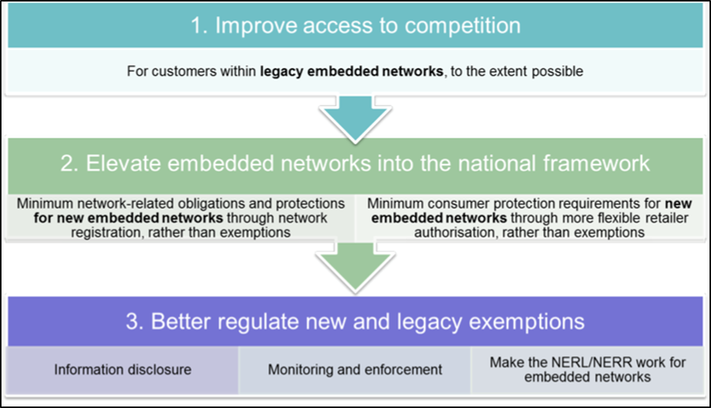
AEMC Draft Recommendations

Slide 10
SACOSS View on AEMC Draft
AEMC’s emphasis on promoting competition, while appropriate at a broader energy policy level, does not adequately address the more specific issues facing small embedded network consumers
Minimum conditions after the regulatory instruments are in place
Issues arising during the interim period and for grandfathered embedded network sites and new exempt small customers

Slide 11
Interim Issues
The likelihood that there will be significant increases in the number and complexity of embedded network and on-selling arrangements in the interim period.
The growth in brownfield conversions, with the potential loss of access to retail competition and consumer protections and further concern with the EIC process associated with these conversions.
Similarly, the prospect of growth in the third party service provider model for embedded network operator and on-selling sites, making it difficult to identify who is accountable for non-compliance with the conditions of exemption.
Existing authorised retailers are currently supplying energy services to embedded network customers but are not subject to either the retail exemption requirements or to requirements on authorised retailers. The submission cited examples of third parties applying for and being granted retail authorisation under limited set of obligations with the stated intention of only servicing embedded network customers.
The lack of clarity in the AEMC’s Draft Report about how all the grandfathered arrangements will operate both before and after the legislative changes. For instance, will there be extension of the AER’s Retail guideline in the interim period that will expand consumer protections and access to dispute resolution.
The lack of clarity around the implications of changing from site specific exemption approvals under the AER’s current framework, to the generic authorisation of new retailers by the AER.
The continuation of access to the exemption framework for new, smaller embedded networks where the costs of becoming a registered network operator or authorised retailer exceed the potential benefits; should the AER’s exemption guidelines reflect the additional vulnerability of consumers in these sites.

Slide 12
Likely Consumer Issues
Explicit informed consent, particularly for brownfield conversions
Pricing arrangements
Metering and billing arrangements
Information provision on terms and conditions of supply
Coercive behaviour such as threats to accommodation
Limiting access to competitive retail offers
Activities of third party service providers

Slide 13
Conclusions
Important role for the Ombudsman in being the ultimate independent arbiter of disputes between customers and the provider of embedded network services
Investigating a number of these issues may be a complex task for the Ombudsman
Changes need to be clearly promoted to potential users of the Ombudsman services
Ombudsman can wield both the ‘carrot and
the stick’

