Slide 1
Empowering low income households through electricity decarbonisation
ACOSS, Brotherhood of St Laurence, The Climate Institute
Supported by Energy Consumers Australia

Slide 2
SUMMARY OF PRESENTATION
Introduce the project “Empowering Vulnerable Households through Decarbonisation”
Set the Scene – Vulnerability, Energy Trilemma, Inclusive and Equitable
Outcome 1 – Electricity priced efficiently
Outcome 2 – Informed and Enabled Consumers
Outcome 3 – Energy Consumed Efficiently and productively
Outcome 4 - Robust Consumer Protections
Outcome 5 – All Households have a capacity to pay
Reducing Australia’s Emissions
We are keen to help
What strategically can we do to help you?

Slide 3
EMPOWERING HOUSEHOLDS PROJECT
Purpose
Transition to lower emissions electricity is inevitable; achieving zero emissions is essential (Paris Agreement objectives).
This transition needs to ensure the challenges facing low income and disadvantage households are addressed. The transition needs to be inclusive and equitable.
Method
Commissioned research – Framework 5 outcomes climate, energy and social policy
National Consultations – community, environment and other key stakeholders. Reference Group, ACOSS Policy Network, 120+
Results
Identified priorities for critical areas of reform and to consider further policy development

Slide 4
ENERGY TRILEMA
Affordability
Prices increased 80% since 2008
Uncertainty of bills - shocks
Retail competition failing – increasing cost
Wholesale prices increasing
Renewable incentives on bill increase cost - regressive
Disconnections increased 47% between 2008 & 2016
More people on retail hardship programs
More people accessing financial support services
Rationing of energy
Security and Reliability
Being compromised in some regions
No planned transition from coal to renewables
Emissions Reductions
Emissions in electricity is increasing
Australia’s targets not in line with Paris Agreement
Electricity sector do heavy lifting in short term
A decade of policy instability, regulatory inaction and blame-shifting among federal and state governments is central to the deterioration of every element of the energy trilemma.

Slide 5
WHAT CREATES VULNERABILITY TO ENERGY STRESS?
Price is only part of the story.
Total cost and ability to pay are crucial.
Influenced by:
energy technologies
market design
upward pressure across the supply chain, including network and retail charges
When and how much energy is used
level of consumer choice and control
Low income & eligibility for concessions
housing circumstance
ability to engage
Govt response to climate change risks
Energy techs
Market designs
Price pressure across supply chain
How energy is used
Choice and control
Housing
Eligibility for assistance
Vulnerability

Slide 6
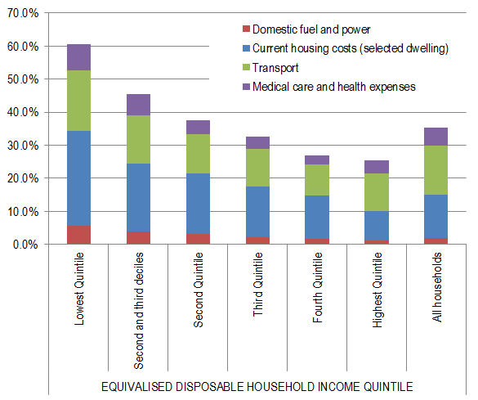
WHO IS VULNERABLE TO ENERGY STRESS?
People who:
a) need to respond to electricity cost pressures, and
b) can't
Particularly vulnerable
Renters
Households where someone is living with a disability or health
Single parent households
Aboriginal & Torres Strait Islanders
Migrants and Refugees
Pensioners
Working poor
Emerging – Housing stressed
Housing tenure is a significant contributor to energy stress

Slide 7
ALIGN ENERGY, CLIMATE & SOCIAL POLICY
Energy concerns
Energy system is in crisis
Improve security & affordability
Need new generation to replace old
Need new framework to adapt to new technologies
Climate concerns
Low income/disadvantaged Australians most vulnerable to climate change impacts
In Australia’s interest in keeping climate change to 1.5-2°C
Transition to net zero electricity supply by mid-century is necessary
Social concerns
Energy is an essential service
Capacity to Pay
Access
Circumstances – health, education, language, geography, disability
Housing costs
Need a planned strategy to manage transition from ageing coal-fired generation to clean energy Urgent need to make this more equitable & accessible for low income and vulnerable Australians Need to better align climate, energy and social policy
vulnerable Australians

Slide 8
WHAT IS TO BE DONE? FIVE POLICY OUTCOMES
Electricity priced efficiently (including integrated climate policy)
Informed and engaged consumers
Energy consumed efficiently and productively
Robust consumer protections
All households have a capacity to pay their energy bills.
Developed by Andrew Nance, The Energy Project
Energy as an essential service – social good – overarching outcome
To date, most policy focus has been on the first outcome, but all need to be pursued in broadly equal measures

Slide 9
OUTCOME 1 - ELECTRICITY PRICED EFFICIENTLY (INCLUDING INTEGRATED CLIMATE POLICY)
Top Priorities Federal government work with COAG Energy Ministers to implement effective and stable policies in the electricity sector consistent with Paris Agreement objectives, comprising a carefully designed package that utilises market mechanisms, regulation and on-budget measures. Federal Government work with COAG Energy Ministers to develop policies for managed coal generator retirement and replacement in the interests of the public, energy consumers, and communities. Other important priorities Federal and state Governments support the development of community and local energy models that enable low-income and disadvantaged households to access affordable distributive energy. COAG Energy Council consider incorporating social and environmental objectives into the National Energy Market objectives (NEO) COAG Energy Ministers implement policies to improve the role and utilisation of the electricity network in contributing to demand management and distributed generation that is inclusive and equitable.

Slide 10
OUTCOME 1 - ELECTRICITY PRICED EFFICIENTLY (INCLUDING INTEGRATED CLIMATE POLICY)
Two views of uncertainty
2030 prices from climate policy modelling

Slide 11
OUTCOME 1 - ELECTRICITY PRICED EFFICIENTLY (INCLUDING INTEGRATED CLIMATE POLICY)
How can we lower prices?
Overarching
Predictability – destination and pathway
Strategy – package of measures
Objectives – security, affordability, decarbonisation, social welfare
Innovation in service provision – new models including community-driven approaches
Fuel costs
Sudden exits
High risk premium
Mismatched incentives
Poor tech integration
Peaky demand
Insecure supply
Market power
More supply
Less uncertainty
Lower tech costs
Lower fuel costs
Improve tech integration
Demand mgmt.
Cost reflection
Competition
Improve productivity
Empowering low income households through electricity decarbonisation

Slide 12
OUTCOME 2 - INFORMED AND ENABLED CONSUMERS
Top Priorities Federal and State Governments co-fund stable and ongoing assistance programs, delivered by local place based social support services to inform and enable vulnerable households engage with the energy market. Where possible these programs should strengthen relationships between vulnerable households, support services, advocates and energy retailers. COAG Energy Ministers require energy retailers to develop a low-cost, no-frills retail energy market offer that vulnerable and disengaged customers can default to if they cannot or do not engage in competitive retail energy markets.

Slide 13
OUTCOME 2 - INFORMED AND ENABLED CONSUMERS
Households who are disengaged from the energy market are paying 15-20% more than should.
Some cohorts of vulnerable households are more disengaged.
Inability to engage makes people more vulnerable
Need to continually engage in the market to benefit.
Barriers exist:
Trust
Transparency
Understanding
Retail is often unavailable and ineffective where available.
Smart meters and network tariff reform: new ways of managing consumption.
benefits not yet realised
some households can’t respond to price signals
Engagement in Distributed Energy – access and affordability
Case Study – QCOSS Switched on Communities
For vulnerable households who can’t engage in energy market access low cost offering.

Slide 14
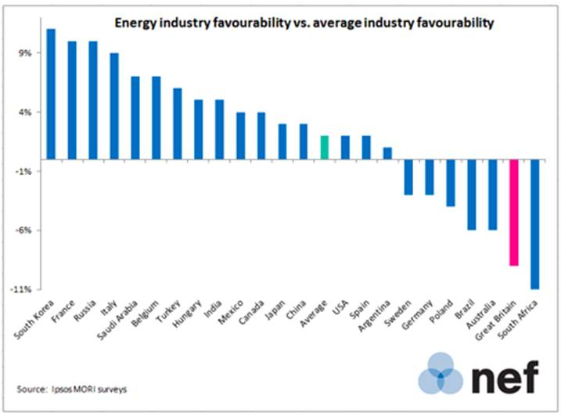
OUTCOME 2 - INFORMED AND ENABLED CONSUMERS

Slide 15
OUTCOME 3 - ENERGY CONSUMED EFFICIENTLY & PRODUCTIVELY
Top Priorities Federal Government support State and Territory Governments to introduce minimum energy efficiency standards for rental properties in all Australian jurisdictions (with reference to local climatic conditions) to improve affordability, health and wellbeing outcomes for tenants in the poorest quality dwellings. Simultaneously the Federal Government review tax policy to ensure existing tax measure support energy efficiency upgrades. Federal, State Governments and local councils work cooperatively together to co-fund ongoing programs for vulnerable and low-income households that provide access to energy efficient technologies, solar PV and other distributed resources and provide a trusted source of information. Higher levels of support should be provided to the most vulnerable households. Other important priorities Federal and State Governments provide additional support to upgrade all public and community housing stock to best practice energy efficiency standards.

Slide 16
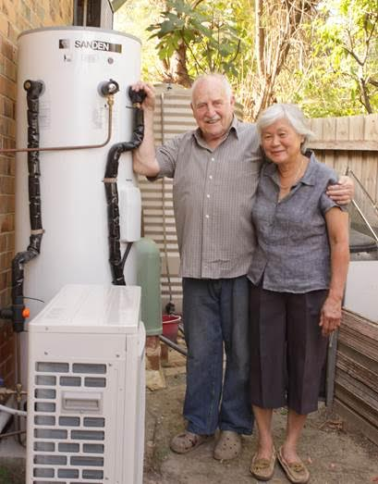
OUTCOME 3 - ENERGY CONSUMED EFFICIENTLY & PRODUCTIVELY
Low-income households pay more for basic energy services:
less efficient homes and appliances
less financial capacity to invest in efficiency
renting adds barriers
Higher costs, disconnections, health and wellbeing impacts
Key initiatives in place, but more needed:
National productivity plan
GEMS/MEPS for appliances
many promising programs (REES in SA, NSW social housing, LIEEP)
Comprehensive approach needed - Stable, long term, rather than stop start
Integrate EE into housing policy, including upgrade pubic & community housing
Harmonise state energy efficiency
PRIORITY ACTION – minimum EE standards for rental – help cost, health, emission reduction

Slide 17
OUTCOME 3 - ENERGY CONSUMED EFFICIENTLY & PRODUCTIVELY
Opportunities in Distributed Energy Resources
solar power, batteries, electric vehicles, smart meters
can lower costs, improve affordability
Also major risks:
solar not accessible to renters, barriers for low income households
but these households pay cost of subsidy schemes
‘two tier’ electricity market? Vulnerable to ‘grid defection’
PRIORITY ACTION: ongoing programs for vulnerable and low-income households that provide access to energy efficient technologies, solar PV and other distributed resources and provide a trusted source of information.

Slide 18
OUTCOME 4 - ROBUST CONSUMER PROTECTIONS
Top Priorities COAG Energy Ministers undertake a review of disconnection laws in light of the essential nature of electricity, with a view to ending the tactic of disconnecting households because of inability to pay. COAG Energy Ministers request a review of the current National Energy Customer Framework (NECF), with the following reforms in mind: Introduce Governing principles along the lines: It should be easy for people to engage and make effective decisions. Appropriate consumer protections should be applied to all energy products and services. The benefits of a transforming market should be shared across the whole community Review of current best practice protections in line with principles Establish a range of no-regrets initiatives: Testing the need for, and form of, market interventions against real consumer decision-making. Requiring energy service providers to identify the consumer’s purpose in acquiring a service, to ensure it is appropriately identifying programs to assist vulnerable demographics access new products and services. Ensuring adequate access to justice by expanding the jurisdiction of energy Ombudsman schemes. Apply updated consumer protection framework in all states, with derogations for stronger protections allowable. Other important priorities COAG Energy Ministers review alternative solutions for those customers identified through Payment Difficulties or Hardship initiatives that are unable to pay for ongoing consumption, such as energy education, financial counselling and support for energy efficiency.

Slide 19
OUTCOME 4 - ROBUST CONSUMER PROTECTIONS
Electricity is an essential service 160,000 households are disconnected each year
National Energy Customer Framework (NECF) inconsistently applied by states.
Some jurisdictions aiming for best practice in some areas (eg. AER, ESC Vic)
But current frameworks are challenged by rising prices and new technologies:
Ambit of NECF and what it applies to needs to be expanded - covers energy retailers but not, embedded energy network operators, and solar PPA/Lease
Energy supply needs to be considered as a whole, rather than arbitrarily divided between the retail market and everything else
Overarching principle
The need for, and level of, regulatory intervention in the interest of providing consumer protection should be based not on the transaction of energy (i.e. on purchase and resale of metered energy), but on:
the extent to which the service or product in question is being relied on by the consumer to deliver the essential service of the continuous supply of electricity;
the impact on the consumer of experiencing payment difficulties and hardship

Slide 20
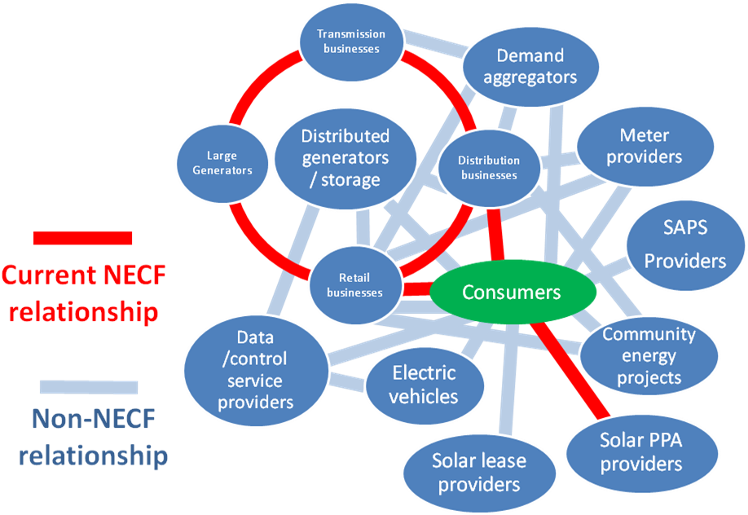
OUTCOME 4 - ROBUST CONSUMER PROTECTIONS

Slide 21
OUTCOME 4 - ROBUST CONSUMER PROTECTIONS
Retail market | Embedded network | Other
Can connect to an energy supply | Yes | N/A?
Minimum reliability, quality, and safety standards, or compensation | Yes and No | Minimal
Sufficient notice for planned interruptions to supply, help re life-support | Largely | ??
Clear info about service being purchased, with contract cooling-off period | Not really | ??
Basis of all charges is clear and subject to regulatory oversight | ?? | No
Access to historical billing data | ?? | No
Access to discounts on their energy costs if concession-eligible | To a point | No
Support and flexibility re payment difficulties, disconnection as a last resort via a regulated process | To a point | No
Access to external dispute resolution service | Mostly no | No
Retain supply during billing disputes without paying disputed amount | ?? | No
Supply uninterrupted If supplier ceases trading | ?? | Depends

Slide 22
OUTCOME 5 - ALL HOUSEHOLDS HAVE THE CAPACITY TO PAY
Top Priorities The Federal Government improves the adequacy of income payments including Newstart and Youth Allowance. Federal and state Governments jointly review concessions schemes to assess: Opportunities to improve and better target concessions to vulnerable households, with a preference towards more equitable percentage based system, and to harmonise their structure across jurisdictions, where substantive differences exist. Ways to improve emergency relief payments, to simplify application processes, and provide greater clarity for customers. Ways to better promote availability of concessions nationally. Other important priorities The Federal Government align policy, advocacy and research initiatives with corresponding housing affordability initiatives. Expand scope to include stronger integration with understanding of transport costs.

Slide 23
OUTCOME 5 - ALL HOUSEHOLDS HAVE THE CAPACITY TO PAY
Ensuring all households can pay for essentials
income measures
energy-specific concessions
attention to broader context
13.3% of population (3 million people) below poverty line
57.3% of those in poverty are reliant on income support payments
Energy concessions vary across jurisdictions
- amount
- coverage
- responsiveness to price increases
Housing affects affordability of all other costs but no institutional recognition of this
Someone needs to take responsibility

Slide 24
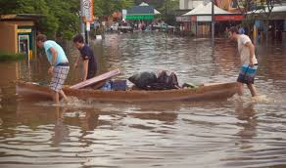
Emissions Reductions Targets
Vulnerable Australia's will be the first and hardest hit by the impacts of a changing climate and have the least capacity to cope, adapt and recover,
Pursue 1.5 degrees
Australia’s targets must align with Paris Agreement – research suggests net zero by 2050
Its policies more than Target that impacts on costs
All industries/economy grow under ambitious targets
Delay and inaction costs more
Setting a credible ling-term target will:
Ensure acting in line with Paris Agreement
Guidance to policy makers and regulators
Send investment signals
Community certainty and confidence
Greater focus on Climate Resilience –
To support people affected by poverty and disadvantage
To support Community Services Organisation who play a significant role in supporting vulnerable people during extreme weather events.

Slide 25
THANK YOU!
Contact us:
Kellie Caught, ACOSS
M: 0406 383 277, E: kellie@acoss.org.au
Olivia Kember, The Climate Institute
M: 0431 615 522, E: okember@climateinstitute.org.au
Damian Sullivan, Brotherhood of St Laurence
M: 0405 141 735, E: dsullivan@bsl.org.au

