Slide 1
Consumers driving transformation
20 February 2017

Slide 3
2010
2000
1990
1980
1970
1960
1950
1940
1930
1920
1910
1900
1800s
Sometimes consumers redefine a market or activity…

Slide 4
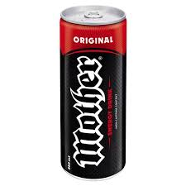
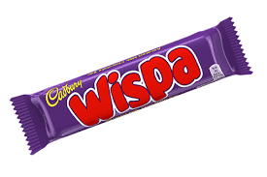
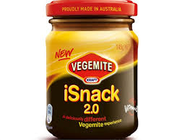
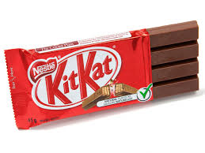
Sometimes consumers drive product change…

Slide 7
What are examples of GOOD customer experience?
Attributes of GOOD
Simple
Intuitive
Works 1st time
Saves time
Unobtrusive upsell
Cool
Attributes of BAD
Doesn’t work
Time consuming
Frustrating
Untrained
Not empowered
Don’t care
Service-centricity
People Technology
Simple Service nature Complex

Slide 10
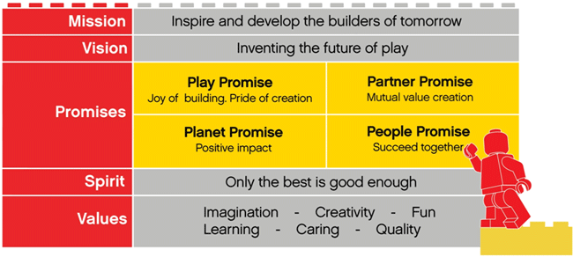

Slide 11
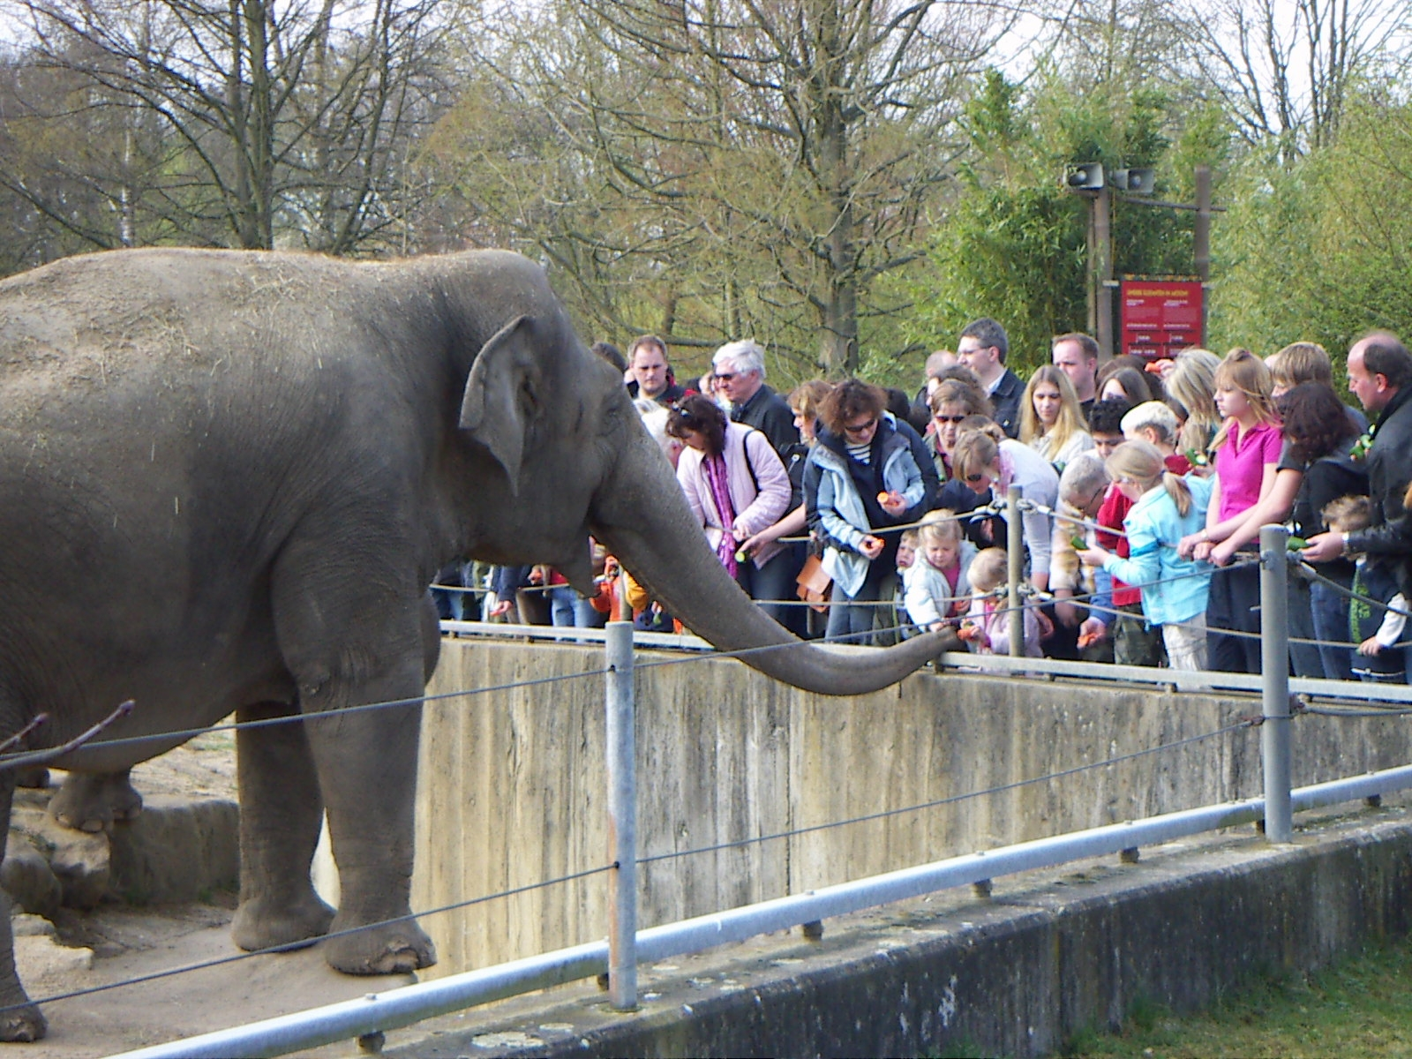

Slide 12
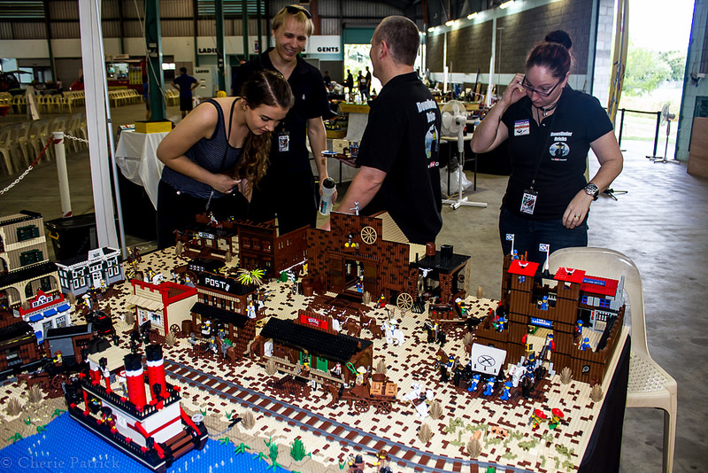
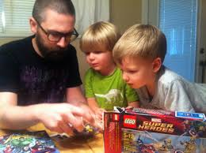

Slide 14
Internet of Things transformation…
Reactive to pro-active
Myopic to holistic
Physical to digital
People to machines

Slide 15
Internet of Things transformation…
Reactive to pro-active
Myopic to holistic
Physical to digital
People to machines

Slide 16
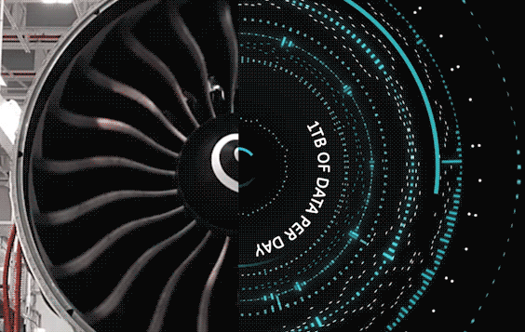
Internet of Things transformation…
Reactive to pro-active
Myopic to holistic
Physical to digital
People to machines

Slide 17
Internet of Things transformation…
Reactive to pro-active
Myopic to holistic
Physical to digital
People to machines

Slide 18
Transformation lessons…
Complementarity
Credibility
Calibrated

Slide 19
Early days of the Internet…
Universities
Big banks
Corporations
Service providers
c.2008…
Universities
Consumers
Service providers
Corporations
Today…
Start Ups
Consumers
Universities?
Corporations?

Slide 20
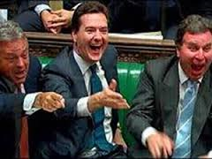
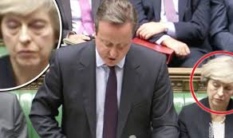
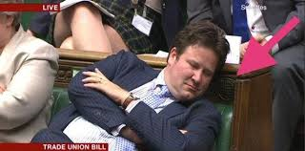
“The Tragedy of the Commons”

Slide 21
“The Tragedy of the Commons”
“The tragedy of the commons is an economic theory of a situation within a shared-resource system where individual users acting independently according to their own self-interest, behave contrary to the common good of all users thereby depleting that resource through their collective action.”

Slide 22
My two cents’ worth…
Customers don’t judge experience against your industry

Slide 23
My two cents’ worth…
Customers don’t judge against your industry
Fully understand the customer journey across all channels

Slide 24
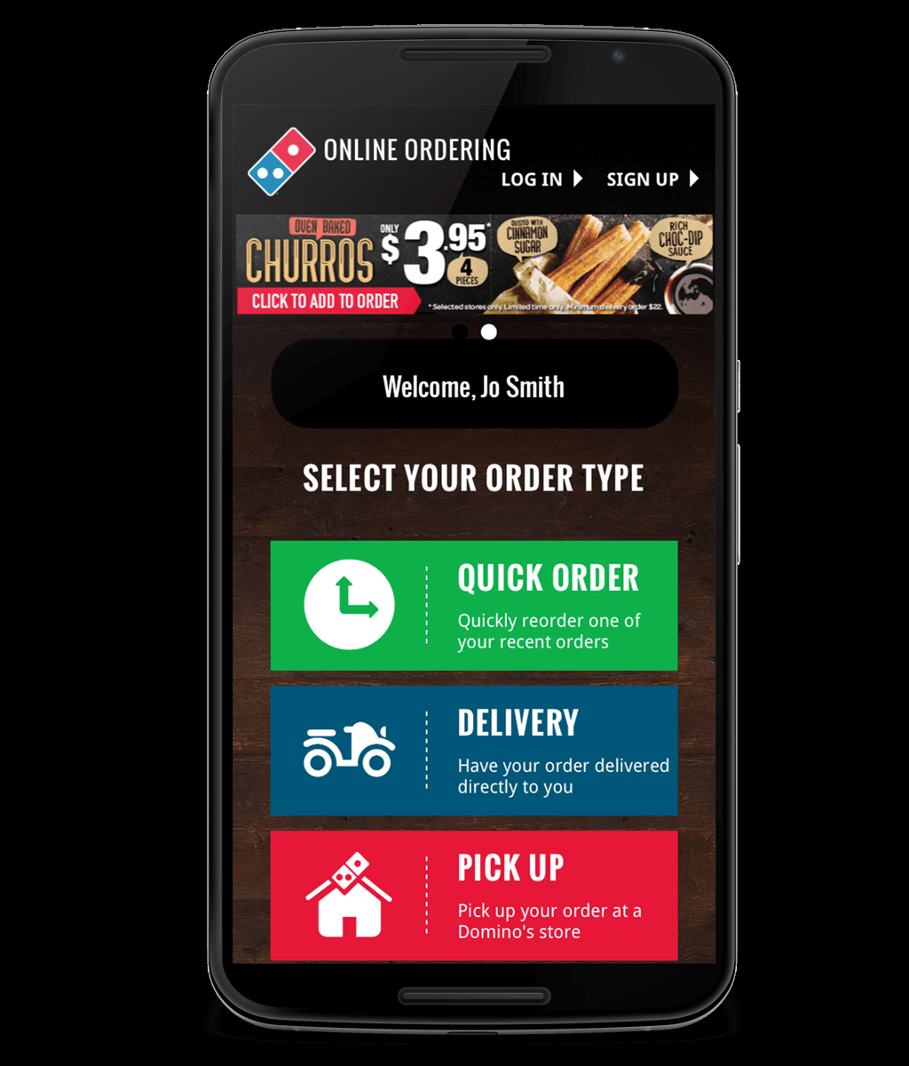
My two cents’ worth…
Customers don’t judge against your industry
Fully understand the customer journey across all channels
Focus on simplicity – remove friction

Slide 25
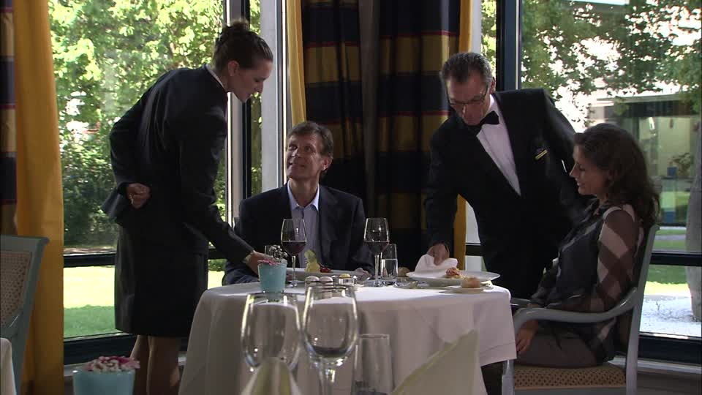
My two cents’ worth…
Customers don’t judge against your industry
Fully understand the customer journey across all channels
Focus on simplicity – remove friction
Customer-centricity is an attitude – it must be pervasive

Slide 26
Malcolm Alder Partner, Orchestrate malcolmalder@orchestrate.com.au +61 414 277315 @exenigma

